Slide 1
Wireless Communication in Multi-agent Autonomous Robotic System
Presents by : Niloofar Bahadori, PhD Student
Advisor : Dr. Fatemeh Afghah

Slide 2

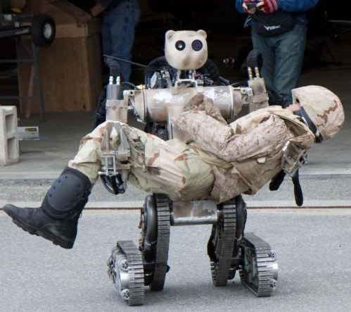

Tasks we could NOT do without a group of robots:
Military mission in harsh and unknown environment
Mass production of sensitive and high quality products
Space exploration
Remote and Minimally-Invasive Surgery
Underwater exploration

Slide 3

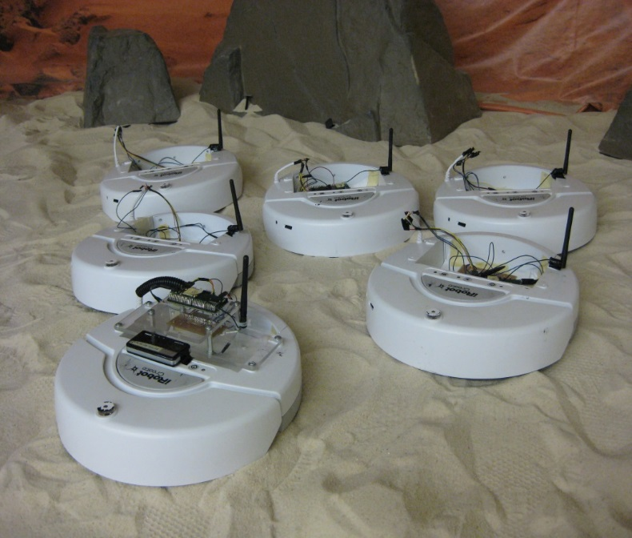
Why communication is important among robots?
Communication capability among a group of robots is a key necessity to:
Negotiate task scheduling
Exchange critical information acquired from robots’ sensors
Receive and relay the orders from the controller

Slide 4
Specification of different wireless communication protocols among a group of nodes
Protocol | Maximum number of nodes | Frequency Band | Range (m) | Data Rate | Power Consumption
WLAN | N/A | 2.4,3.6,5(GHz) | 100-300 | 54 (Mbps) | High
Bluetooth | 8 nodes | 2.4 (GHz) | 100 | 2.1 (Kbps) | Low
Infrared | N/A | 2.4 (GHz) | 1 | 2.4 (Kbps) | Low
ZigBee | 255 | 2.4 (GHz) | 75 | 250 (Kbps) | Very Low
Magnetic Induction | N/A | 15 (MHz) | 3 | 100-300(bps) | Very Low

Slide 5
Different types of communication networks
Centralized networks
There is a main controller node called base station (BS)
All the nodes communicate with each other through BS
Pros: higher number of nodes, more accurate
Cons: expensive- overhead signaling- dependency on the BS
Distributed networks (ad-hoc networks)
The network is established for a very specific application
Nodes can share information directly
Pros: low cost- easy to set up- using unlicensed frequency spectrum
Cons: low transmission rate, more susceptible against jamming, dynamic topology

Slide 6
MANET
Due to the specific nature of robot-based networks, the suitable wireless communication interface should be:
Power efficient (battery life is an important factor in wireless nodes)
capable of direct communication (in cases of no infrastructure for base station)
Self-organizing
Decentralized ad-hoc network (Short range communication)
“Mobile Ad-hoc Communication Network” (MANET) is a group of mobile nodes with limited resources such as, processing capability and storage capacity, which form a temporary unpredictable network.
The network is decentralized and autonomous, where all network activity including discovering the topology and delivering messages must be executed by the nodes themselves.

Slide 7
MANET design requirement
Distributed Operation and Self Organization
No node in the ad hoc network can depend on a network in the background to support the basic functions like routing instead it should be performed in decentralized manner.
Since topology changes due to mobility, the network should be self-organized to adapt to the changes.
Dynamic Routing
Table-driven routing
It is fast but causes signaling traffic and power consumption
Source-initiated on-demand routing
Package will wait until route is discovered, but less signaling for update
Connectivity
In connected ad hoc network, for any node there must be a multihop path to any other node.

Slide 8
Game theory and MANET
Based on the application, the proper communication network can be selected. However, there are many technical challenges to be tackled before establishing the network, namely: power-control, spectrum allocation, security.
Numerical optimization methods are widely employed to address the mentioned technical problems. However, when the number of independent parameters and the nodes increases, they become less practical in terms of computational complexity and time.
Thanks to the recent advancements in electronics and software, robots are becoming more and more intelligent, cognitive, and capable of making strategic decisions based on the situation.
Game theory is a well-know and suitable mathematical framework to model the interactions among the wireless nodes by taking advantage of the robots’ aforementioned capabilities.
Game theory better captures the interactions among the nodes, gives us a better understanding of strategic actions in different situations, and is specially suitable for analyzing the interactions among large number of nodes with different performance function.

Slide 9
A brief introduction to Game Theory
Game Theory is an strong mathematical tool to model the interaction in an autonomous multi-agent cognitive mobile agents network.
Component of the Game | Elements in a wireless network
Players | Nodes in the wireless network
The set of strategies | modulation scheme, Coding rate, transmit power level, forwarding packet or not.
The set of pay-offs | Performance metrics (e.g. Throughput, Delay, SINR, etc.)

Slide 10
Game Theory
Non-Cooperative
Interaction and decision making among competitive players
Each player choose its strategy independently to improve its own performance
Possible solution: Nash Equilibrium
Cooperative
Study behavior of rational players when they cooperate
Possible solution:
Bargaining game
formation of coalition

Slide 11
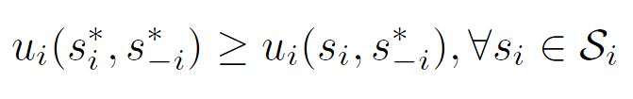

Non-Cooperative game
Game in Strategic Form
Dominating strategy
Player's best strategy, regardless of other players’ strategy
Nash equilibrium
Mixed strategy
Strategies are pure if a player i selects, in a deterministic manner, one strategy out of its strategy set S_{i} , if selecting based on probability distribution over their set of strategies
Dynamic non-cooperative game
Extensive form
the notion of time and information is important
Repeated game
average utility over time
1
2
Confess
(-5,-5)
Confess
Quiet
(0,-10)
Confess
(-10,0)
Quiet
Quiet
(-2,-2)

Slide 12
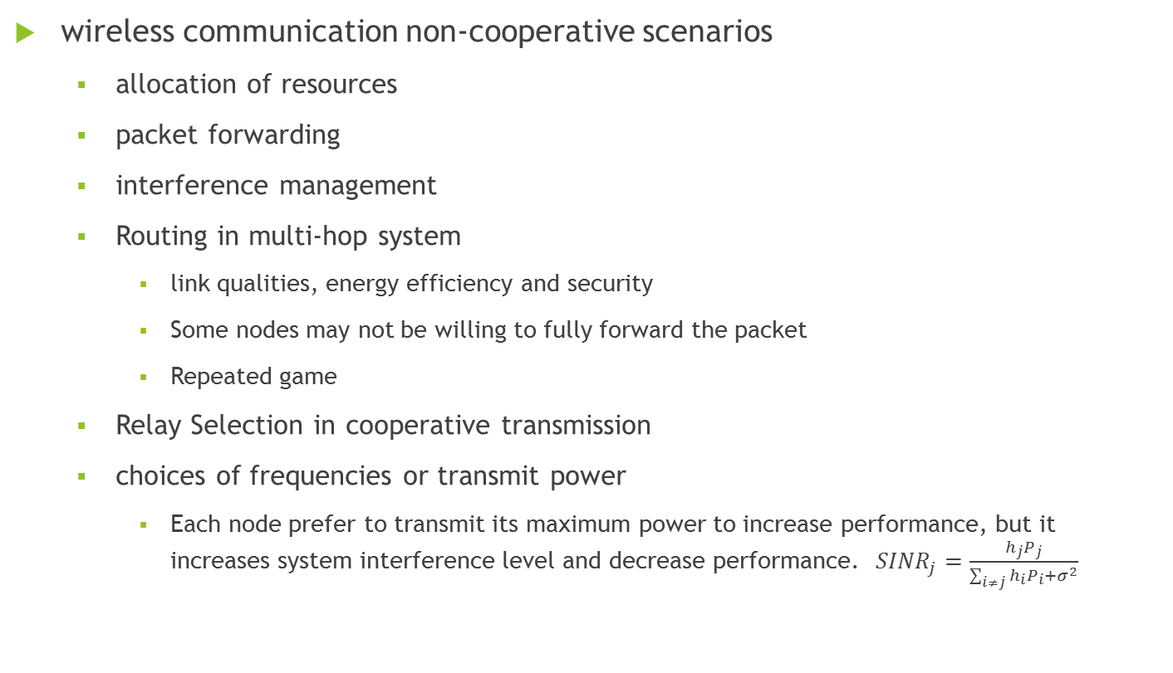
Non-Cooperative Game
wireless communication non-cooperative scenarios
allocation of resources
packet forwarding
interference management
Routing in multi-hop system
link qualities, energy efficiency and security
Some nodes may not be willing to fully forward the packet
Repeated game
Relay Selection in cooperative transmission
choices of frequencies or transmit power
Each node prefer to transmit its maximum power to increase performance, but it increases system interference level and decrease performance. ${SINR}_{j}=\frac{h_{j}P_{j}}{\sum_{i≠j}{h_{i}P_{i}+σ^{2}}}$

Slide 13
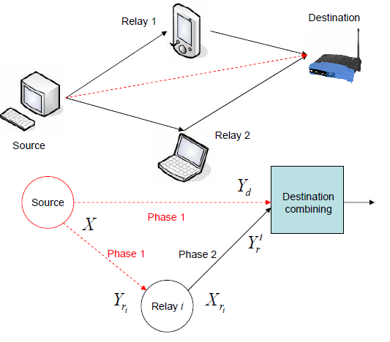






Cooperative Communication
transmit cooperatively as a virtual antenna array, thus, providing diversity that can significantly improve system performance
Transmission in two phases
Phase 1, the source broadcasts a message to the destination and relay nodes.
In Phase 2, relay nodes send information to the destination (in different time slots or on different orthogonal channels), and the destination combines messages from the source and relays.
capacity region of his communication channel can be significantly increased
Direct Transmission cooperative Transmission

Slide 14
Cooperative Communication concerns
Relay selection and power control
Which relay nodes select as
how limited power resources should be distributed over sources and relays
Solution: stackelberge :
How many nodes should cooperate
How much service should be bought

Slide 15
Special type of non-cooperative game
Stackelberge Game
a hierarchy among the players exist
one or more of the players (Leader) declare and announce their strategies before the other players(Follower) choose their strategies.
Application: Power Control and Relay Section for Cooperative Transmission
Sender buying the services from the relays to improve its performance, such as the transmission rate
Relays selling service, such as power, by setting prices
Tradeoffs: price too high, sender buying others; price too low, profit low; sender decides to buy whose and how much to spend
Procedures: convergence to the optimal equilibrium
Note : term “non-cooperative” does not always imply that the players do not cooperate, but it means that, any cooperation that might arise must be self-enforcing with no communication or coordination of strategic choices among the players.

Slide 16
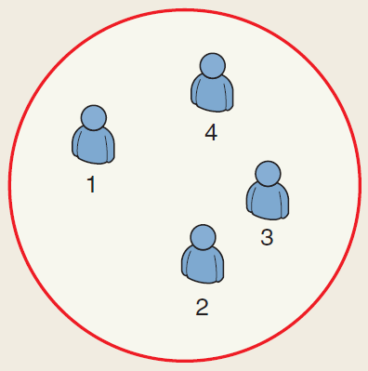
Cooperative Coalitional Game Theory
Canonical Coalition Game
It is beneficial to all players to join the coalition. Grand coalition is the optimal solution
Main objective:
properties and stability of grand coalition
how to distribute gain from cooperation in fair manner between player (Core)
Pay-off allocation solution : Core, Shapley value and the nucleolus

Slide 17
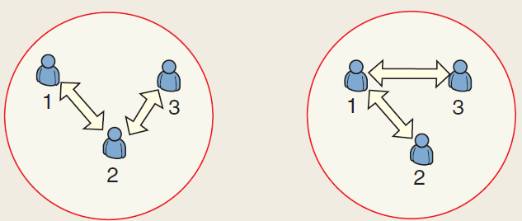





Cooperative Coalitional Game Theory
Coalition Graph Game
Internal interactions among players inside each coalition impact the outcome of each coalition
Main Objective
To drive a low complexity and distributed algorithm for players that wish to build a network graph
study the stability, efficiency of the formed network graph.
$$Coalition S=\{1,2,3\}$$
$$Coalition S=\{1,2,3\}$$
$$Graph G_{s1}$$
$$Graph G_{s2}$$
$$v(G_{s1})≠v(G_{s2})$$

Slide 18
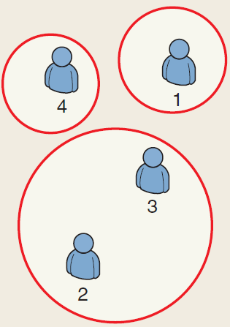
Cooperative Coalitional Game Theory
Coalition Formation Game
Forming a coalition brings gains to its members, but the gains are limited by a cost for forming the coalition (negotiation process or an information exchange), hence the grand coalition is seldom the optimal structure.
Main objective
optimal coalition size
assess the structure’s characteristics
The coalitional game is subject to environmental changes such as a variation in the number of players, a change in the strength of each player, or other factors that can affect the network’s topology.

Slide 19
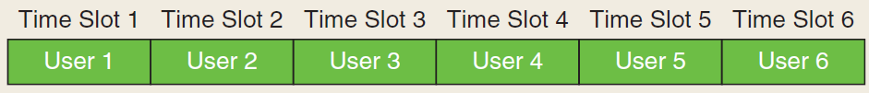
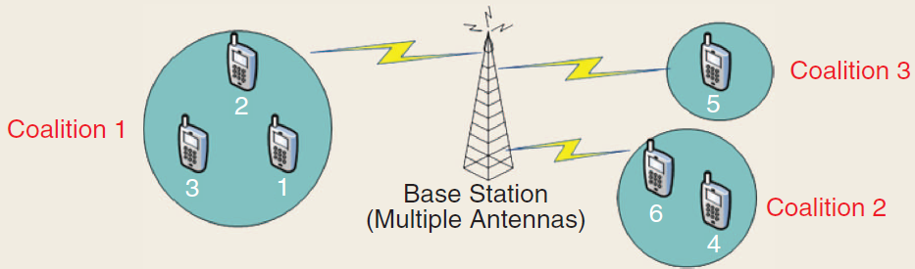
Coalition Formation Game Application
Virtual MIMO
A network of single antenna transmitters that send data in a TDMA system to a multiple antenna receiver.
In a non-cooperative approach, each single antenna transmitter sends its data in an allotted slot.
For improving their capacity, the transmitters form coalitions, whereby each coalition S is seen as a single user MIMO that transmits in the slots that were previously held by the users of S.

Slide 20
Coalition Formation Game Application
Virtual MIMO
To cooperate, users must exchange data, and hence, this exchange of information incurs a cost in terms of power that is increasing by
Distances of nodes inside the coalition
when two users are far away, information exchange can consume the total power, and the utility for cooperation is smaller than in the non-cooperative case
size of coalition
So Grand Coalition is not beneficial.
Value function sum-rate, or capacity, that the coalition can achieve

Slide 21
Coalition Formation Game Application
Virtual MIMO
Coalition Formation Algorithm (sequential merge and split)
Start with non-cooperative network
each user discovers its neighbors (starting with the closest)
If cooperation with a neighbor improve its utility then merge
if a formed coalition finds out that splitting into smaller coalitions improves the total utility achieved by its users, then a split occurs
merge-and-split periodically, and hence, adapt the topology to any environmental change, such as mobility or the joining/leaving of transmitters.
end

Slide 22
Application of Game Theory in Robotic Communication
Sensor sharing
Limited facilities and we can equip limited number of robots to sensor network to collect the data from the environment. This robots can be act as leader in system and other robots in vicinity of each of them can form a coalition and interact with this leader in their coalition to use their information to accomplish their task.
Energy harvesting
These energy producer nodes can go through the network and to recharge nodes that demand for energy (consumer nodes) and charge them without human intervention
Multi hop communication
In a defined team work to a group of robots an amount of work would be assigned to each robot, after accomplishing the work it can be act as a relay between other nodes.

Slide 23
References
[1]T. Alpcan and T. Ba»sar. Distributed algorithms for Nash equilibria of °ow control games. Annals of Dynamic Games - Advances in Dynamic Games: Applications to Economics, Finance, Optimization, and Stochastic Control, 7:473{498,2005.
[2] T. Alpcan and T. Ba»sar. Network Security: A Decision and Game Theoretic Approach. Cambridge University Press, 2011.
[3] T. Alpcan, T. Ba»sar, R. Srikant, and E. Altman. CDMA uplink power control as a non-cooperative game. Wireless Networks, 8(6):659{670, November 2002.
[4] E. Altman, A. A. Kherani, P. Michiardi, and R. Molva. Non-cooperative For- warding in Ad Hoc Networks. Springer Berlin Heidelberg, May 2005.
[5] E. Altman, A. A. Kherani, P. Michiardi, and R. Molva. Non-cooperative Forwarding in Ad Hoc Networks. Springer Berlin Heidelberg, May 2005.
[6] . J. Aumann and B. Peleg. von Neumann-Morgenstern solutions to cooperative games without side payments. Bulletin of American Mathematical Society, 6:173{179, 1960.
[7] T. Ba»sar. Control and game theoretic tools for communication networks (overview). App. Comput. Math., 6:104{125, 2007.
[8] T. Ba»sar and R. Srikant. A Stackelberg network game with a large number of followers. Journal on Optimization Theory and Applications, 115:479{490, December 2002.

Slide 24
References
[9]H. Boche and M. Schubert. Nash bargaining and proportional fairness for wire- less systems. IEEE/ACM Trans. Networking, 17:1453{1466, October 2009.
[10] A. Chan and S. C. Liew. Performance of VoIP over multiple co-located IEEE 802.11 wireless LANs. IEEE Trans. on Mobile Computing, 8(8):1063{1076, August 2009.
[11] V. Chandrasekhar, J. G. Andrews, Z. Shen, T. Muharemovic, and A. Gatherer. Distributed power control in femtocell-underlay cellular networks. Proc. IEEE Global Telecommunications Conference (GLOBECOM 2009), pages 1{6, 2009.
[12] Z. Chen, A. Vorobyov, C.-X. Wang, and J. S. Thompson. Nash bargaining over MIMO interference systems. In Proc. Int. Conf. on Communications, pages 1{5, Dresden, Germany, June 2009.
[13] M. Felegyhazi, M. Cagalj, and J. P. Hubaux. E±cient MAC in cognitive radio systems: A game-theoretic approach. IEEE Trans. on Wireless Communications, 8(4):1984{1995, April 2009.
[14] Z. Han and K. J. R. Liu. Noncooperative power-control game and throughputgame over wireless networks. IEEE Trans. Commun., 53(10):1625{1629, October 2005.
[15] Z. Han and V. Poor. Coalition games with cooperative transmission: A cure for the curse of boundary nodes in sel¯sh packet-forwarding wireless networks.IEEE Trans. Comm., 57:203{213, January 2009.

